Slide 1
INPUT–OUTPUT CHANNELS

Slide 2
A person’s interaction with the outside world occurs through information being received and sent: input and output. In an interaction with a computer the user receives information that is output by the computer, and responds by providing input to the computer – the user’s output becomes the computer’s input and vice versa. Consequently the use of the terms input and output may lead to confusion so we shall blur the distinction somewhat and concentrate on the channels involved.

Slide 3
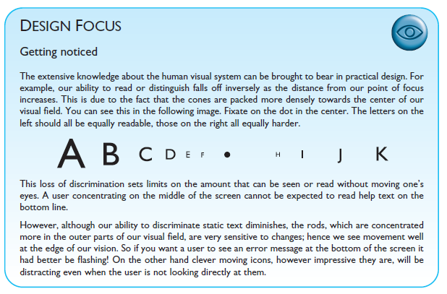
Vision

Slide 4
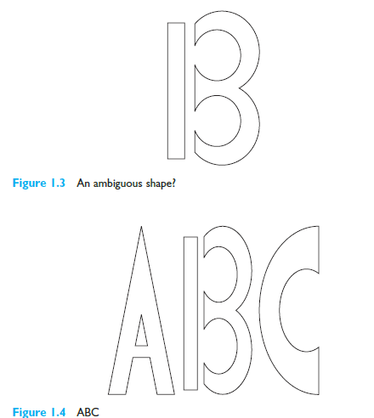

Slide 5
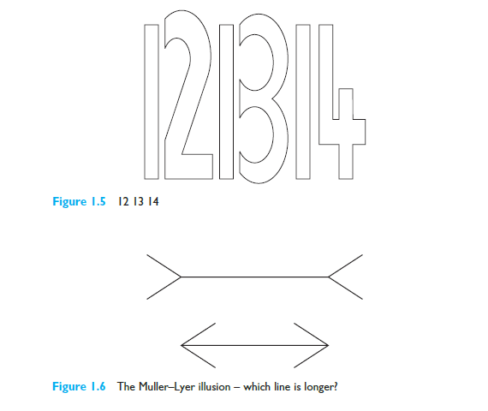

Slide 6
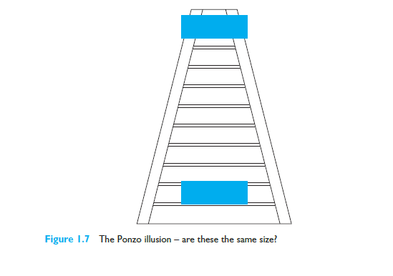
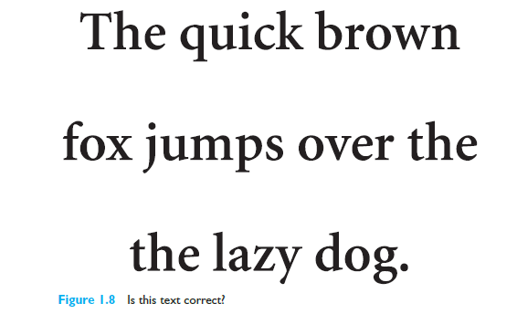

Slide 7
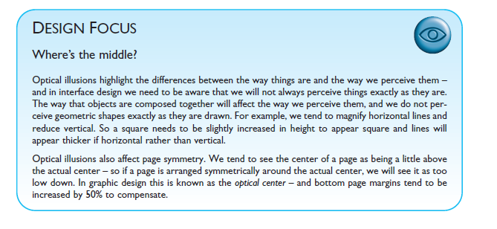

Slide 8
Hearing & Touch

Slide 9
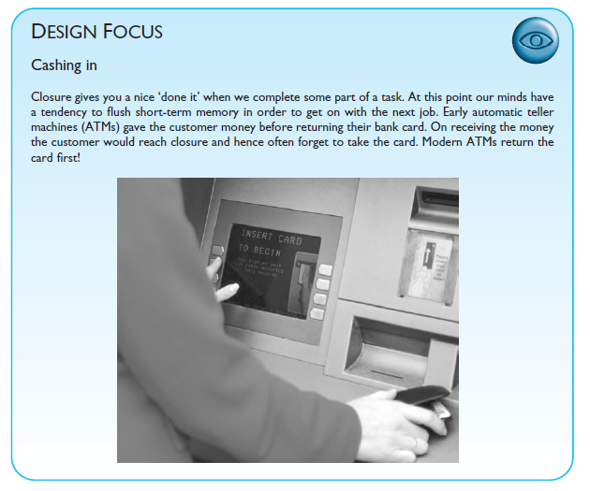

Slide 10
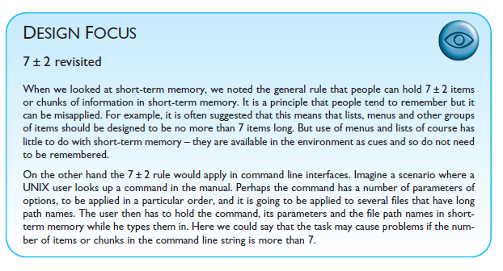

Slide 11
THINKING: REASONING AND PROBLEM SOLVING

Slide 12
Reasoning is the process by which we use the knowledge we have to draw conclusions or infer something new about the domain of interest. There are a number of different types of reasoning: deductive, inductive and abductive. We use each of these types of reasoning in everyday life, but they differ in significant ways.
If reasoning is a means of inferring new information from what is already known, problem solving is the process of finding a solution to an unfamiliar task, using the knowledge we have. Human problem solving is characterized by the ability to adapt the information we have to deal with new situations. However, often solutions seem to be original and creative. There are a number of different views of how people solve problems.

